Slide 1
Introducing AeroBi
GKN Filton | Productivity Tracker

Slide 2


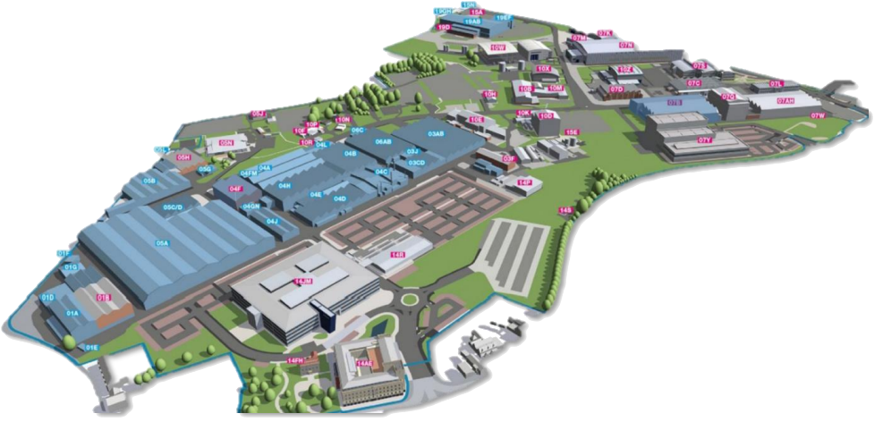


An all-in-one Business Area - Value Stream –
Work Center Productivity Tracker
Based on Microsoft Fabric the tracker can be viewed on a web browser or Microsoft PowerBi mobile app.
Fabric is currently in a trial period with GKN. Everyone with a Microsoft account currently will have access. You can log in now on www.microsoft.com/en-us/microsoft-fabric/getting-started - select ‘Try for free’ and enter your Microsoft log in details.
You will need an invite to the OpEx. AeroBi dashboard to view the tracker.
The PowerBi app can be found in the app store on your mobile. Once logged in it will connect to your Fabric ‘My workspace’. Once invited to the AeroBi dashboard you can access the tracker.
The tracker breaks down from Business Area to individual Work Centers - calculating STVs divided by Attended Hours, taken from SAP, to give a productivity percentage.
| AeroBi

Slide 3

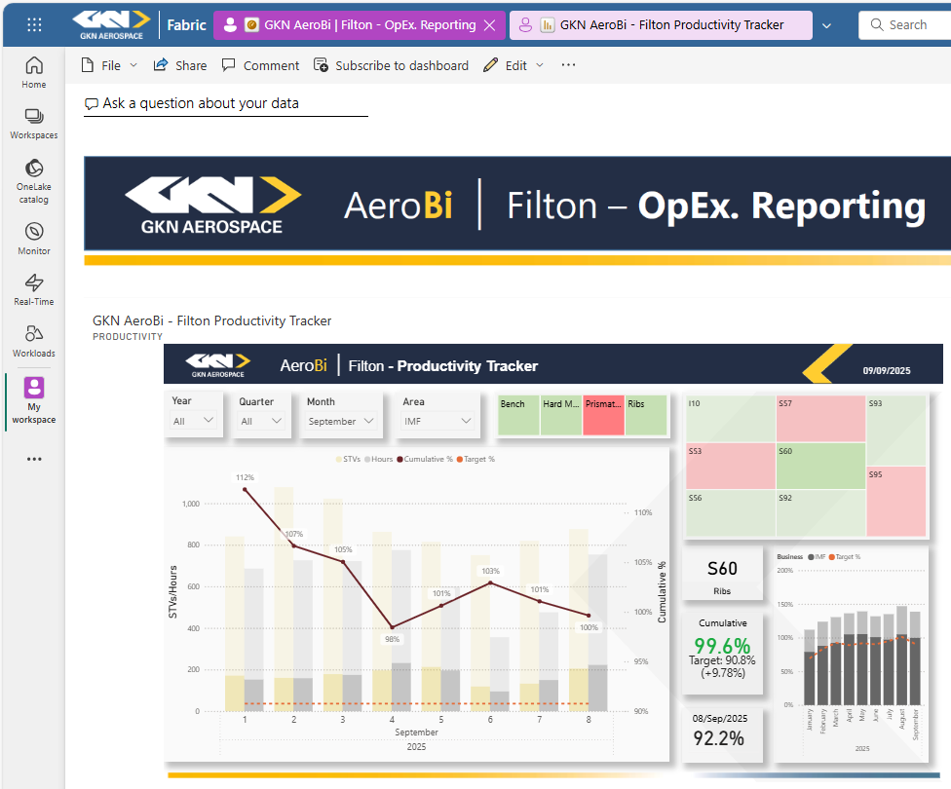
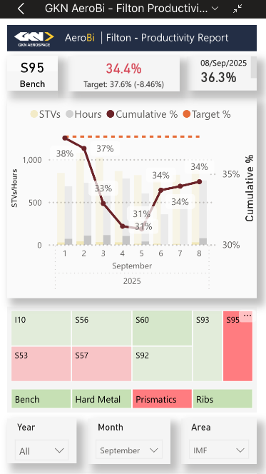

Fabric Web Browser
Once you have the OpEx. Reporting invitation you can view the dashboard in your ‘My workspace’.
You can either use the tracker on the dashboard, or by clicking the three dots at the top right of the report you can enlarge by choosing the ‘Go to report’ option.
There is an option to subscribe to the report where you can schedule an email notification to the dashboard.
The productivity tracker will be refreshed with the latest STV/Hours data to the OpEx. Reporting dashboard before 9am each morning (we’re working on getting this time earlier).
PowerBi App
The app will take you to your ‘My workspace’. By selecting the OpEx. dashboard you can view the tracker.
Clicking on the report will open it into a mobile view.

Slide 4
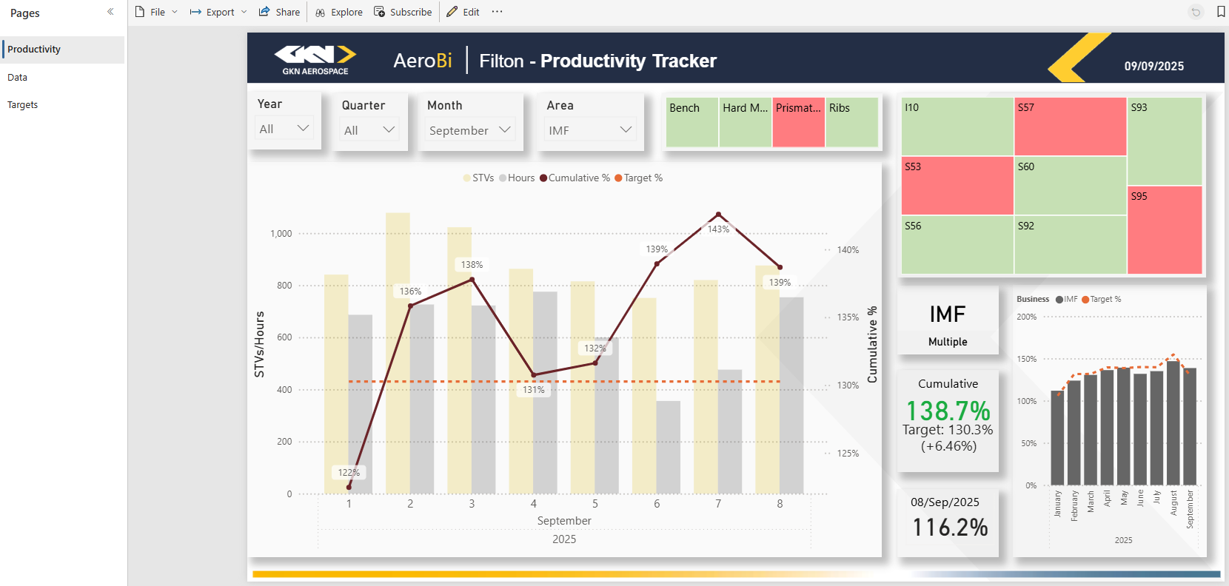
Fabric Web Browser Report
Hovering over the dropdown boxes and selecting the eraser will clear filter
Use the dropdown filters for Dates and Business Area.
Business area will dynamically change the Value Stream and Work Center selection options.
Green/Red visual shows what areas are above or below their target
There are two other pages available to view and filter through the data that drives the Productivity page.
Selecting a Business Area, Value Stream or individual Work Center will update the charts and data to the selected area.
The months graph will show Cumulative % and Target % for Business Area only.
When a Value Stream or Work Center are selected the bar will show how that selection contributed to that Business Area.
The main graph shows STV and Hours on the left y-axis visualised as a bar chart, a cumulative % on the right y-axis visualised as a solid line with data points and a target % visualised as a dashed line.
The bars are grouped for the areas, selecting a Work Center will adjust the bar to show how that area contributes to the groups %.
Clicking on a bar or line will show the data for that date.
Hovering the mouse over an area, bar, line or card will call out the latest data for that point.
The data cards show the area that the data is showing for, cumulative % - Green is plus, Red is minus - target %, delta cumulative from target, and the previous days % - if ‘NA’ is shown the report hasn’t been updated or the month selection isn’t for the current month.

Slide 5
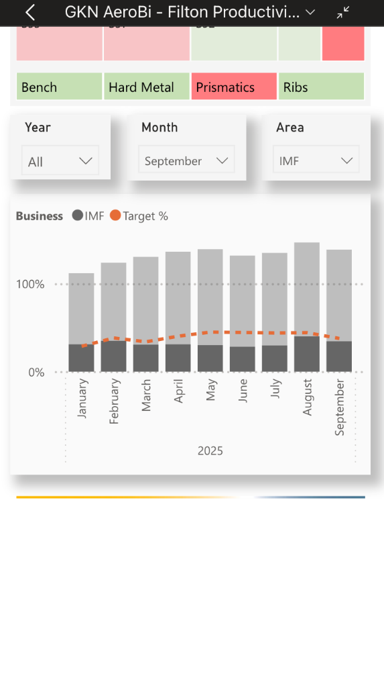

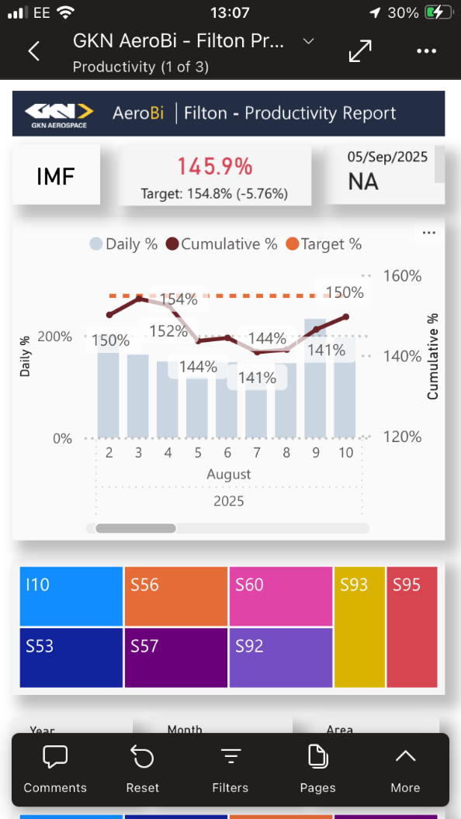
PowerBi App Report
Scroll down to view months graph.
The data cards show the area that the data is showing for, cumulative % - Green is plus, Red is minus, target %, delta cumulative from target, and the previous days % - if NA is shown the report hasn’t been updated or the month selection isn’t for the current month.
The main graph shows daily % on the left y-axis visualised as a bar chart, a cumulative % on the right y-axis visualised as a solid line with data points and a target % visualised as a dashed line.
In mobile view the graph is shows up to 9 days at a time, scrolling from left to right gives the user full visual of the month.
Green/Red visual shows what areas are above or below target
Select Pages from the ribbon that appears at the bottom of the screen to view Raw Data.
Selecting a Business Area, Value Stream or individual Work Center will update the charts and data to the selected area.
Drop down filtering for Dates and Business Area.
Rotating your mobile horizontally will display the tracker into landscape mode.

Slide 6


Further Information
The dashboard is now live and ready to be shared with business leaders, along with this introduction pack.
Additional reports/trackers are currently in development and will be released through the dashboard in due course, accompanied by further communications.
We welcome any questions, feedback, or ideas to enhance the dashboard and trackers - please feel free to reach out to any member of the team.

Slide 7

OpEx. Team Mission:
Our mission is to drive Operational Excellence through Continuous Improvement, Innovation, and Efficiency. We foster a Positive, Inclusive workplace that enhances Wellbeing, Boosts productivity, and delivers lasting value to our stakeholders for Sustainable growth.

